Slide 1

Voice Commands for Webex
(1) Enabling Webex Teams with Voice Recognition
(2) OS Supported: Mac/Win/Ubuntu
By : Devang Sharma, Sarthak Jain, Lakshmanan G

Slide 2

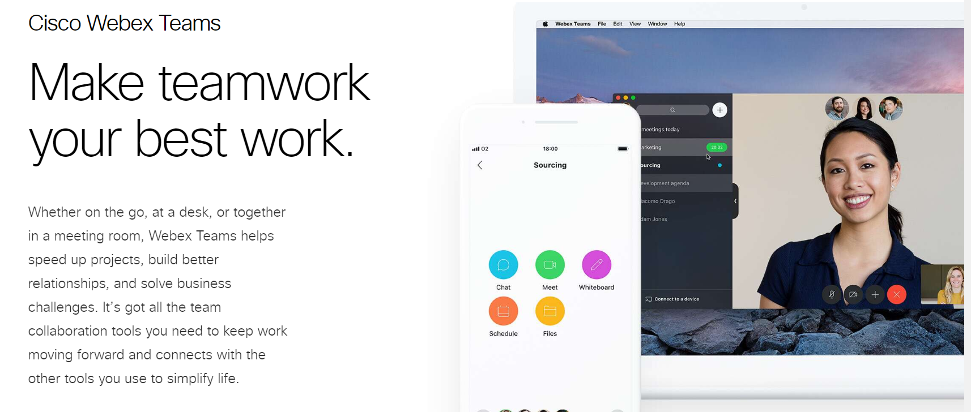

Slide 3
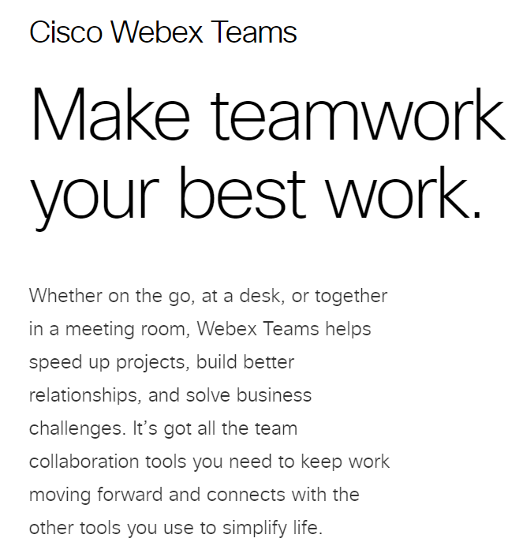


Slide 4
Benefits of voice commands
(1) Cross-Platform Support:
Now, connect with anyone from your Teams Client, with simple voice commands irrespective of the platform or OS.
(2) Enabling Hands Free Technology
Join a Team Meeting whilst driving
Call a co-worker on your bike
Send a message and multitask
(3) Faster and Greater Ease of Use
Users don’t have to navigate through GUI’s
(4) Aiding the Visually-impaired

Slide 5
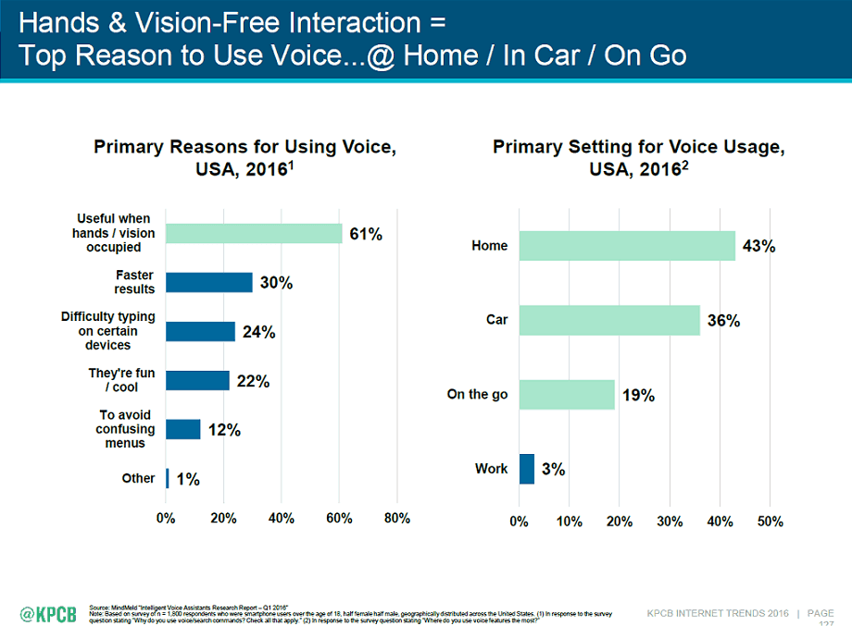
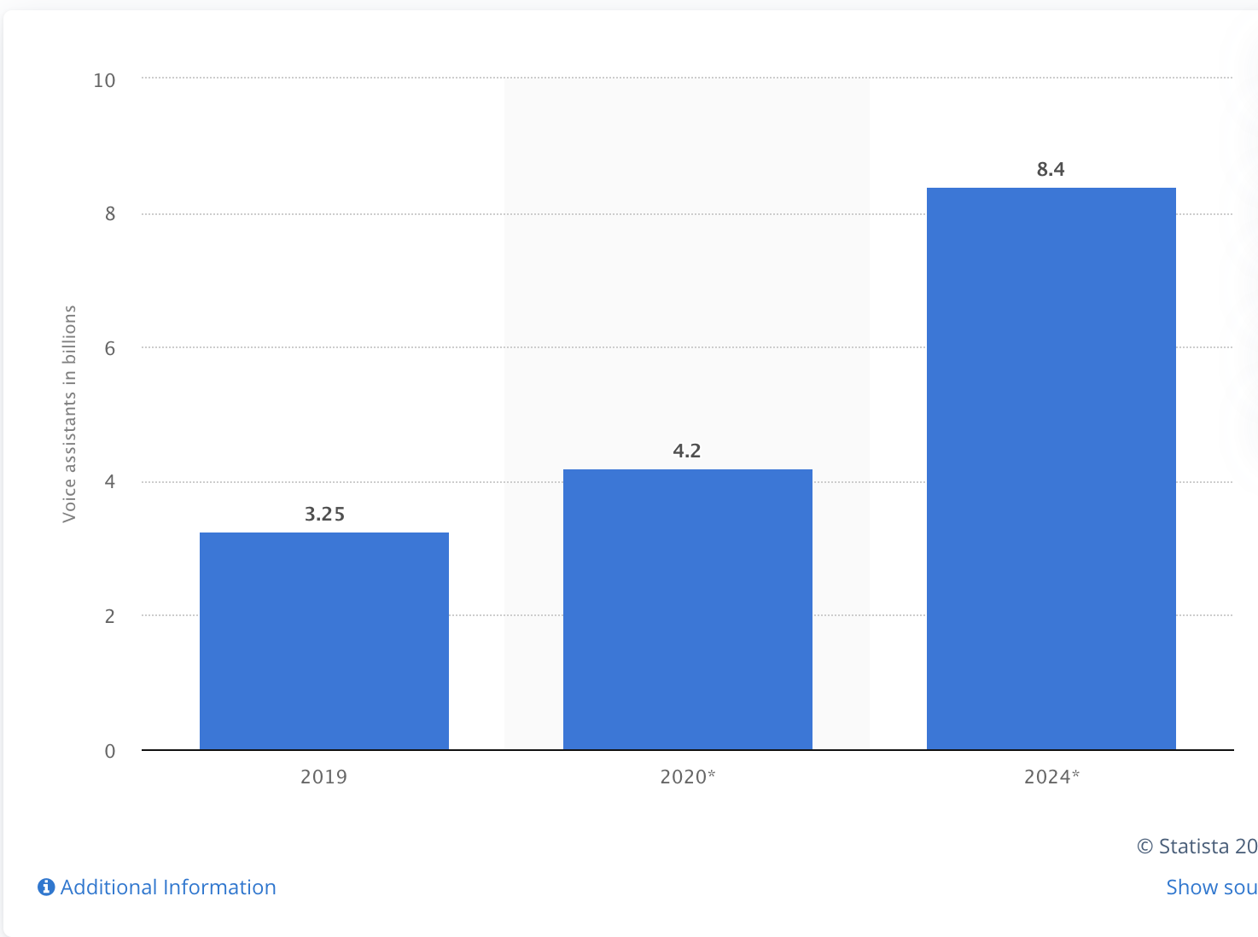
Trends of growth of voice assistant among variety of customers in the market

Slide 6

Source:
https://seoexpertbrad.com

Slide 7




^{OUR COMPETITORS}

Slide 8

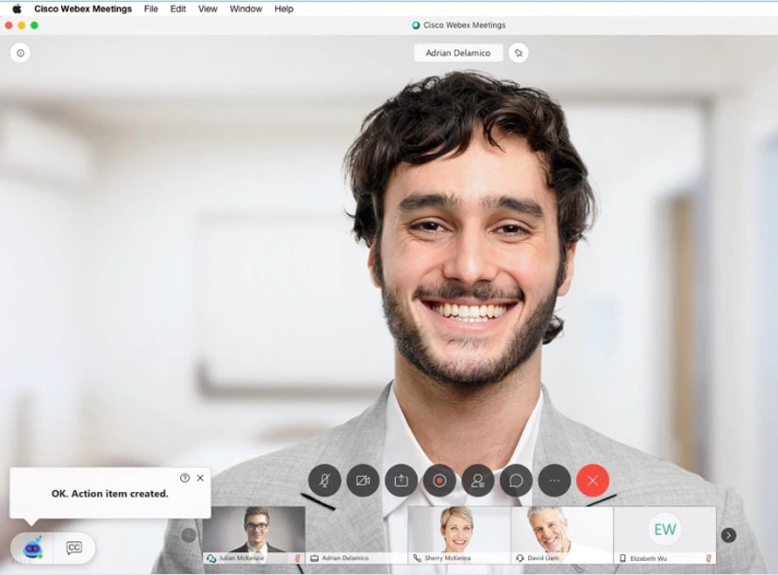
How We Are Better?
We provide with an enhanced voice assistant which does a lot of tasks for you, just by speaking.
Example: Setup a meeting, call a co-worker, set reminders and much more.

Slide 9
Development Process
Two subparts - voice recognition with Siri and using WebEx to start a call
Voice recognition:
Using Siri (SiriKit) would require rewriting code at the application level so chose to use dictation instead for proof of concept
Wrote an AppleScript to use the Dictation app on Mac OS to catch phrases and run a shell script when those phrases are caught
WebEx integration:
Since the WebEx API and SDKs do not tie in to one particular GUI, we used the WebEx browser SDK to initiate a call using the browser as a backup in case working with the Desktop application was not possible
Found protocol handlers for WebEx app on Mac OS which made it possible to use the Desktop application by using the handler and passing the username as an argument

Slide 10
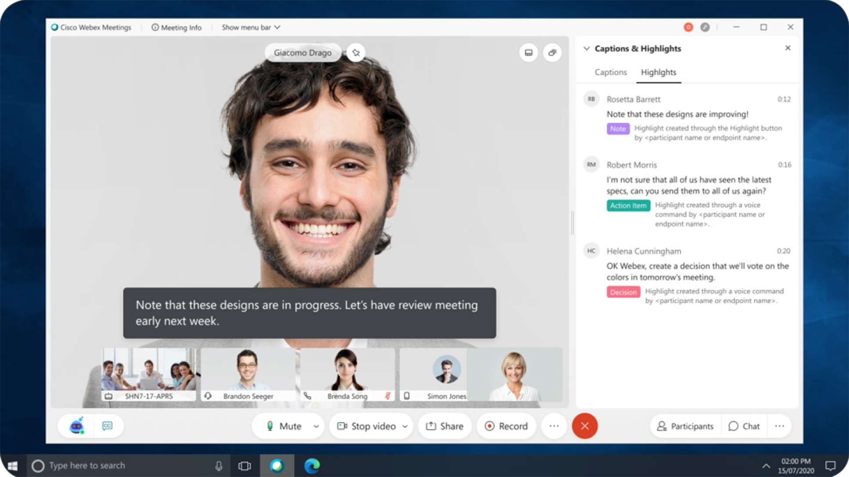
DEMO
https://youtu.be/retZDawHbSA
DEMO VIDEO LINK:
https://youtu.be/retZDawHbSA

Slide 11
Possible Future Applications
“Call Devang Sharma on Webex Teams”
“Schedule an appointment at noon tomorrow with Devang Sharma and Lakshmanan on Webex Teams”
“Message Sarthak Jain on Webex Teams that I can’t make the meeting”
“Message in the Server Team space on Webex Teams that the deadline is this week”
“Answer call on Webex Teams”
Integration with Siri

Slide 12
Thank you for listening!

